Slide 1
WEEK 3 · DOMAIN ANALYSIS
Agency Under
Surveillance
Automated watching is scaling faster than anyone's ability to refuse it.
Sophia · Sissi · Yash · Flora · Daniel
Notes:
Open with the tension: surveillance is becoming automated and networked, while the people being watched have almost no visibility or control over how their data is collected, used or shared.

Slide 2
One company became the argument
License plate readers, police and drone cameras, facial recognition, gunshot detection, workplace and retail monitoring, doorbell networks, and the brokers that fuse them. Flock Safety sits at the centre of the public fight.
120,000+
5,000+
$7.5B
50+
ALPR cameras
across 49 states
law enforcement
agencies as customers
valuation at its
March 2025 raise
officers accused of
misusing the data
What the misuse looks like
Why it stopped being local
26 of the 50+ cases involved officers tracking wives, girlfriends, exes, or women they wanted to approach.
One Georgia deputy searched a single woman's plate 1,639 times.
Searches needed only a free-text reason. "Investigation" was the most common entry.
Agencies share data across the network with a click, so a local traffic tool became a national one.
Federal immigration enforcement gained access to camera data built for local traffic use.
Carpenter (2018) requires a warrant for cell-site location data. It binds government, not a vendor.
Sources: Flock Safety press release and GlobeNewswire (Mar 2025) · Washington Post ALPR misuse investigation (Aug 2026) · CNN and Institute for Justice ALPR abuse database (2026) · Carpenter v. United States, 585 U.S. 296 (2018)
Notes:
The $7.5B figure is from the March 2025 raise led by a16z. Later reporting puts the private valuation near $8.4B in April 2026, so present $7.5B as the confirmed number and mention the newer one only if asked.

Slide 3
2026 is the year it turned
Five years took the technology from a specialised police tool to a national network. One year produced the backlash.
2021
2022–24
2024–25
2026
A specialised tool
The default purchase
It goes national
The public arrives
ALPRs are niche police equipment bought by a handful of departments.
VC-funded growth makes Flock standard for small cities and a common HOA amenity.
Cross-agency sharing reaches federal immigration enforcement.
Audits name individual officers; opposition turns organised and cross-partisan.
The counter-movement, in one year
50+
Aug 31
30 → 7
Apr 20
cities and counties cancelled or deactivated ALPR systems in 2026, across 23 states
Florida revoked every ALPR permit in state highway rights-of-way, reaching roughly 2% of the state's cameras
days: Flock cut default retention, added case codes, and made auditing mandatory by end of 2026
ACLU, ACLU of Virginia and EFF filed a Fourth Circuit amicus in Schmidt v. City of Norfolk
Sources: Washington Examiner and DeFlock contract tallies (2026) · Florida DOT memorandum, 31 Aug 2026 · Flock Safety policy announcement (Aug 2026) · ACLU, Schmidt v. Norfolk amicus brief, 20 Apr 2026
Notes:
The Florida order is loud but narrow: it cancels encroachment permits on land the state controls, which independent analysis puts at roughly 2% of Florida's cameras. Contract cancellations at city council level remain the mechanism actually removing cameras.

Slide 4
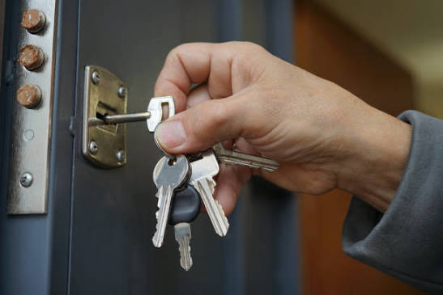

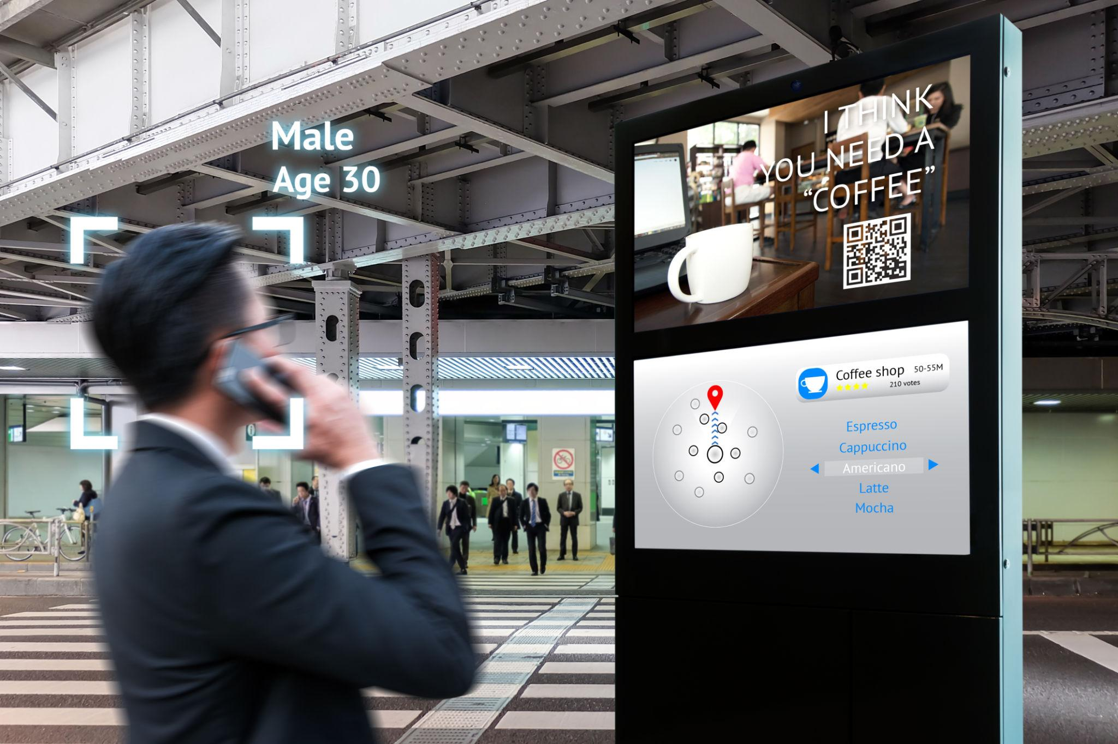


Scenario analysis
Two axes: how much government is involved, and whether handing over data is optional.
OPT-IN COLLECTION
MANDATORY COLLECTION
Personal Data Ownership
Corporate Surveillance
LOW
GOVERNMENT
Transparent Network
Surveillance State
HIGH
GOVERNMENT
Notes:
The key move: the two right-hand quadrants are separated by a purchase order, not by capability. The Fourth Amendment limits what government may take, not what it may buy. That is why regulating only the government column fails.

Slide 5
Scenario analysis
Two axes: how much government is involved, and whether handing over data is optional.
OPT-IN COLLECTION
MANDATORY COLLECTION
Personal Data Ownership
Corporate Surveillance
LOW
GOVERNMENT
Private surveillance exists, but you can see, restrict, or delete what is held about you
Personal data becomes a resource companies must ask for
Firms collect and use extensive personal data with little ability for you to see or control it
Companies predict what you will buy before you know
Transparent Network
Surveillance State
HIGH
GOVERNMENT
The state builds the collection infrastructure, but using it is not required
A regulator audits algorithms; state access needs a warrant and is logged
Daily tasks require disclosure, such as a face scan to check out at the grocery store
Government access is unrestricted and monitoring is real-time
Where we are now: high collection, low formal government involvement, and the state buys access rather than building it.
Notes:
The key move: the two right-hand quadrants are separated by a purchase order, not by capability. The Fourth Amendment limits what government may take, not what it may buy. That is why regulating only the government column fails.

Slide 6
Opportunities in the high-government quadrant
Problems, not solutions. Each already exists in small form today.
01
02
03
No view into your own file
Scored without knowing why
Make the search costly
People may have little visibility into when their data is accessed, why, how long it is kept, or which agencies it reaches.
Government systems may continuously score, classify or predict behaviour without people knowing what data shaped the decision.
There will be a need to make each surveillance query hard to run, not merely easy to review afterward.
WHO Citizens, journalists, courts, oversight bodies
WHO Benefit and licence applicants, people flagged by risk scoring
WHO People searched for personal reasons; agencies facing liability
WHY Without visibility, misuse cannot be challenged and errors cannot be found. As datasets connect, the consequences compound.
WHY Algorithmic judgments affect major life opportunities, and correcting a bad profile built from thousands of signals is very hard.
WHY Every existing control is a log, and a log only reports what already happened. One deputy ran 1,639 searches before anyone noticed.
SIGNAL GAO found Treasury did not fully implement data-protection controls before granting DOGE staff access to payment systems (Apr 2026).
SIGNAL Across 11 selected agencies, GAO found reported AI use cases nearly doubled, from 571 in 2023 to 1,110 in 2024.
SIGNAL 50+ officers charged or accused; one victim brought the audit logs to a judge and was still denied a restraining order.
The lesson from Norfolk and Georgia: the audit logs already existed. Knowing was not enough.
Sources: GAO-26-108131, Treasury Needs to Fully Implement Data Protection Controls (28 Apr 2026) · GAO-25-107653, Generative AI Use and Management at Federal Agencies (29 Jul 2025) · Washington Post (Aug 2026) · Institute for Justice ALPR abuse database (2026)
Notes:
If asked which is strongest, say 03. The other two are transparency measures, and the Norfolk and Georgia cases show transparency already existed and did not stop the harm.

